Slide 1

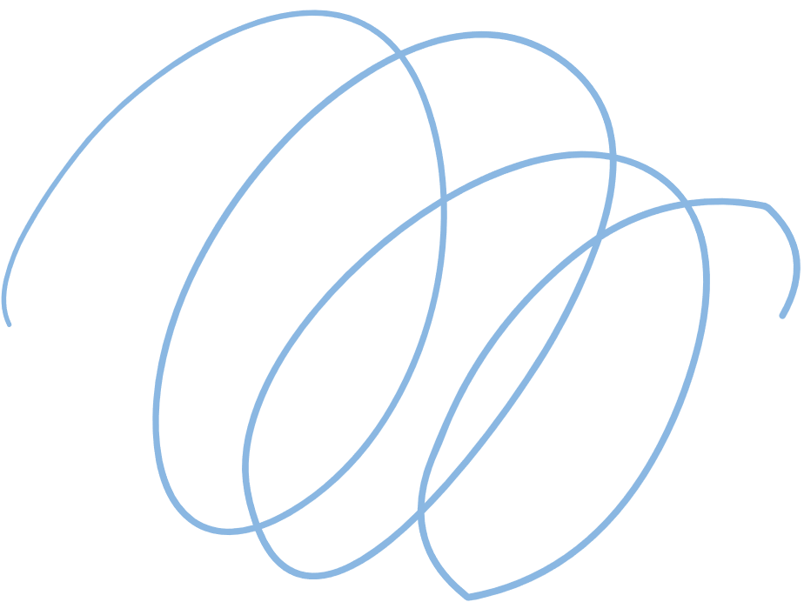













DAA
Optimized Debt Settlement Using Greedy approach and Heap Structures

Slide 2

2
PRESENTED BY
BAPA RAO
2024

Slide 3
INTODUCTION TO THE PROBLEM
01
02
Debt Settlement
Complexity
Identifying the optimal way to settle debts among a group of people to minimize the total number of transactions.
The problem becomes increasingly challenging as the number of people and debts increases, requiring efficient algorithms.

Slide 4

Minimize Total Transactions:
Calculate Net Balances Efficiently:
Reduce the number of individual transactions required to settle debts among multiple people using a minimal transaction strategy.
Process the input transactions to calculate the net balance for each person, identifying who owes money (debtors) and who is owed money (creditors).
OBJECTIVES
Use Efficient Data Structures for Optimization:
Greedy Matching of Debts
and Credits:
Implement a min-heap structure to maintain and efficiently access the minimum debt or credit amount, allowing faster matching and settlement of balances.
Use a greedy algorithm to match debtors and creditors, minimizing each transaction amount by the smallest possible balance at each step until all debts are settled.

Slide 5

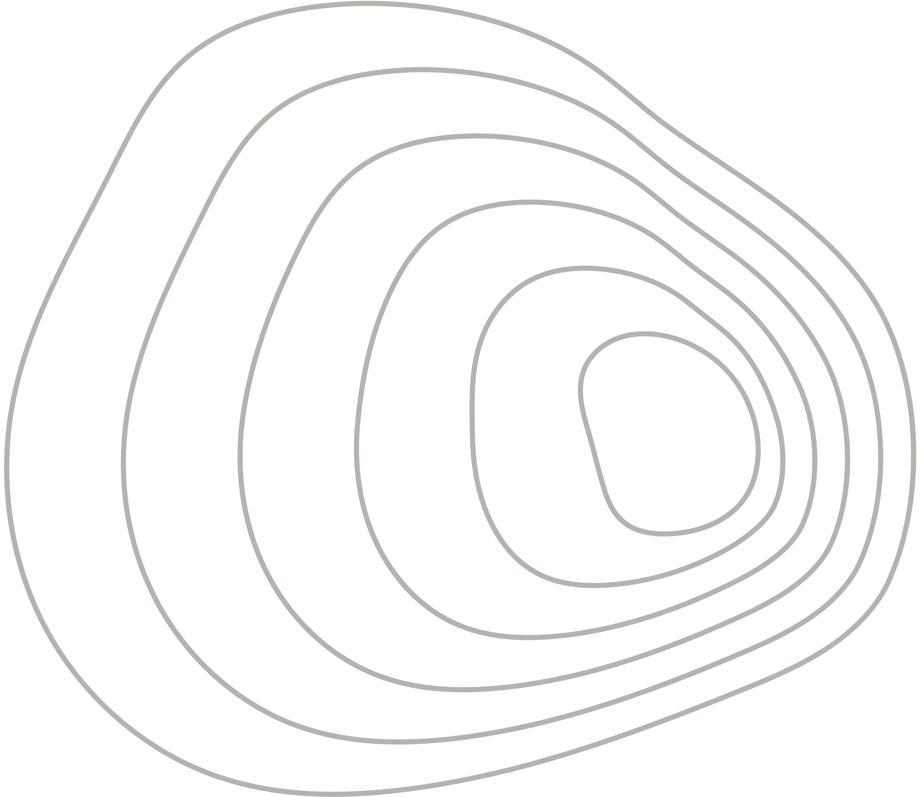
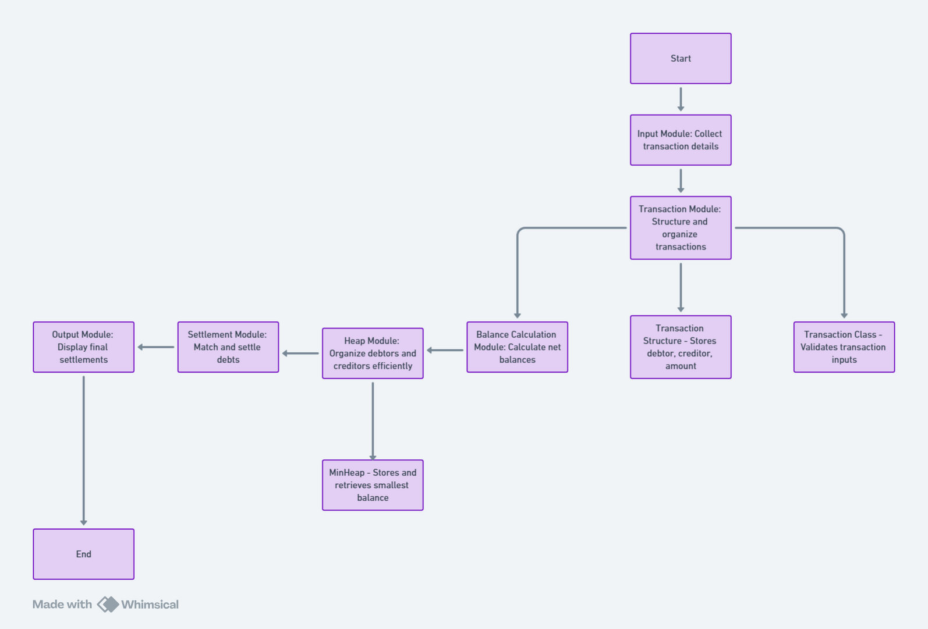

Module overview

Slide 6
IMPLEMENTATION FLOWCHART
1
2
3
4
5
Loop until all debts are settled:
1. Pop the minimum debtor and creditor from heaps
2. Settle debt by minimum of the two 3. Display transaction 4. Update remaining balances, push back to heap if balance remains
Prompt user for number of transactions
Gather transaction details from user (Debtor, Creditor, Amount)
Calculate net balance for each person by adding positive amounts for creditors and negative for debtors
Display total transactions minimized

Slide 7
Performance Analysis of the Debt Settlement Program
Time Complexity
Input Processing: O(n) for processing transactions.
Heap Operations: O(n log n) due to push() and pop() operations on debtors and creditors.
Settlement Processing: Runs up to O(n log n).
Overall Time Complexity: Approximately O(n log n).
2. Space Complexity
Transactions Storage: O(n) for storing all transactions.
Balances Storage: O(n) for net balances of participants.
Heap Storage: O(n) for managing debtors and creditors.
Overall Space Complexity: O(n).

Slide 8
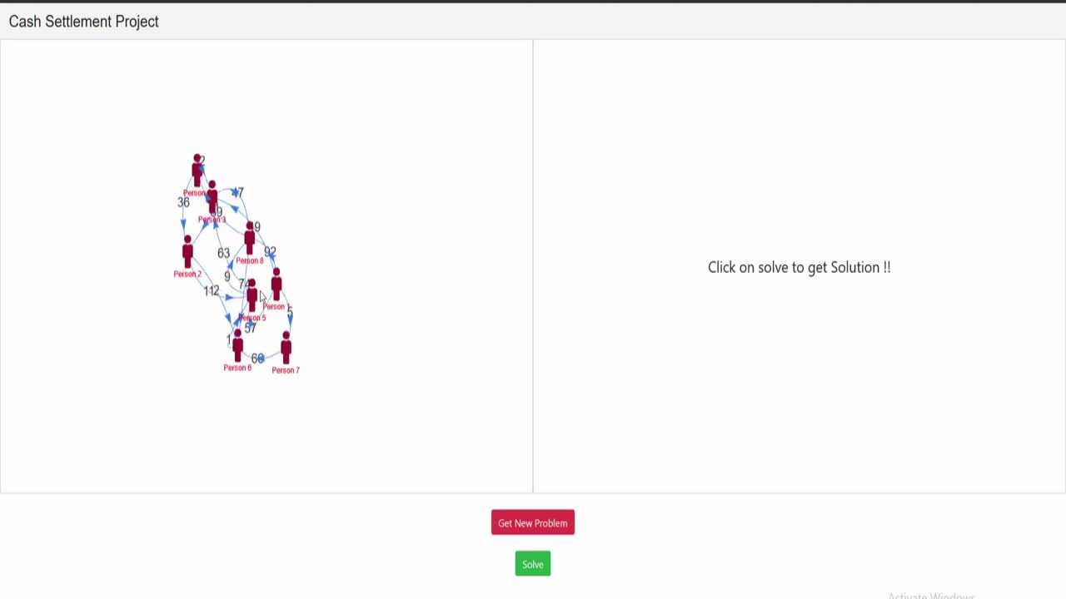

Slide 9
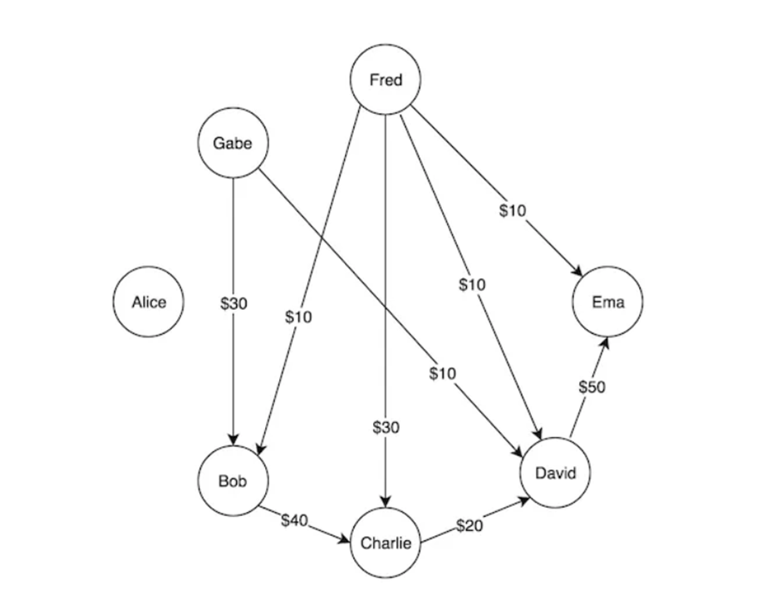
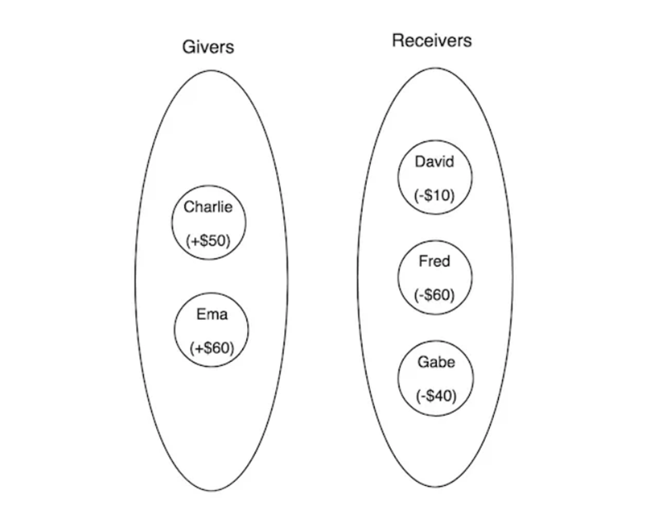
EXAMPLE PROBLEM

Slide 10
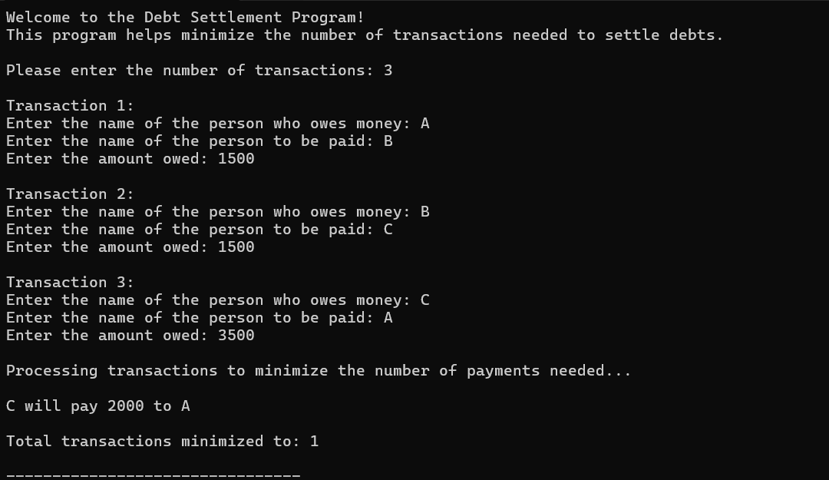
SAMPLE OUTPUT

Slide 11
CONCLUSION
The Debt Settlement Program achieves an efficient and user-friendly solution for resolving multiple debts among people with minimal transactions. By employing key strategies such as net balance calculations, min-heap structures, and a greedy algorithm, the program effectively minimizes the number of payments needed to settle all debts.
Transaction Minimization: reduces redundant payments, saving both time and resources.
Greedy Approach ensures each transaction maximally reduces balances, achieving an optimal settlement path.
In summary, the program effectively simplifies the debt resolution process, ensuring minimal transactions and clear visibility of settlement details. This makes it a valuable tool for managing complex debt networks with accuracy and efficiency.

Slide 12
Thank you very much!

